Slide 1
Terrain Model Generation from Point Cloud
Vatsal Ketan Patel (A20458061)
Quick Savajiyani (A20451378)
Aditi Desai (A20444864)

Slide 2
Introduction
A point cloud is a set of data points in space. Point clouds are generally produced by 3D scanners, which measure many points on the external surfaces of objects around them.
Point clouds are used for many purposes:
Creating 3D CAD models for manufactured parts
Metrology and quality inspection
For a multitude of visualization, animation, rendering and mass customization applications.

Slide 3
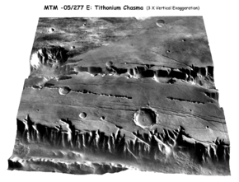
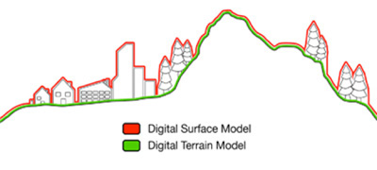
Terminology
3D rendering of a DEM on Mars
Digital Surface Model (DSM) refers to the Earth’s surface and includes all the objects on it.
In contrast to a DSM, Digital Terrain Model (DTM) represents the bare ground surface without any objects like plants and buildings.
A digital elevation model (DEM) is a digital model or 3D representation of a terrain’s surface- commonly for a planet (including Earth), moon or asteroid- created from terrain elevation data.

Slide 4
Terminology
All datasets which are captured with satellites, airplanes or other flying platforms are originally DSMs.
It is possible to compute a DTM from high resolution DSM datasets with complex algorithms.

Slide 5
Digital Elevation model(DEM)
A DEM can be represented as a raster ( a grid of squares, also known as a heightmap when representing elevation) or as a vector- based triangular irregular network (TIN).
The TIN DEM dataset is also referred to as a primary (measured) DEM, whereas the Raster DEM is referred to as a secondary (computed) DEM.
DEM can be acquired through techniques such as photogrammetry, lidar, lfSAR, land surveying etc.

Slide 6
DEM
DEMs are commonly built using data collected using remote sensing techniques, but they may also be built from land surveying.
They are often used in geographic information systems and are the most common basis for digitally produced relief maps.
While a DSM may be useful for landscape modelling, city modelling and visualization applications, a DTM is often used for flood or drainage modelling, land- use studies, geological applications, and other applications.

Slide 7
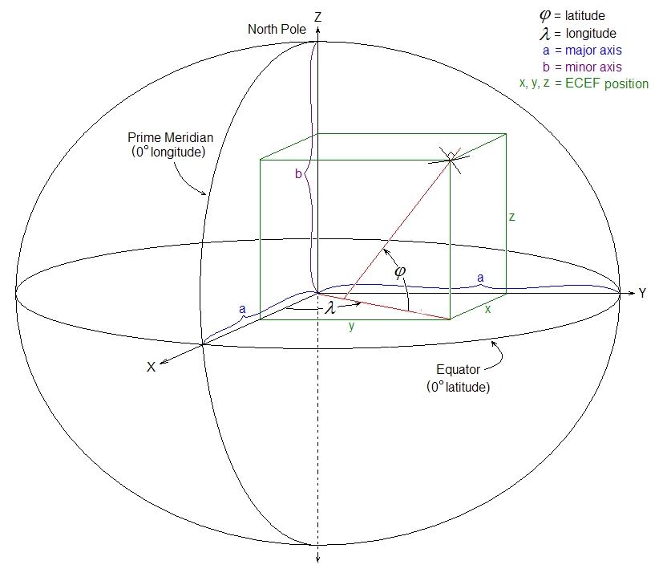
ECEF
ECEF (acronym for earth-centered, earth-fixed), also known as ECR (earth-centered rotational), is a geographic and Cartesian coordinate system and is sometimes known as a "conventional terrestrial" system. It represents positions as X, Y, and Z coordinates with point (0,0,0) defined as center of mass for Earth.

Slide 8
Methodology used
Import the Point Cloud file which is the .fuse file.
Create a function to read and write data from the .fuse file.
Create a function to convert the data in Point cloud file which is in degrees to radians using Earth centered Earth Fixed Algorithm(ECEF).
Then, convert from degrees to radians and save those values to another file.
Then we represented that values in a matrix for generating terrain.
Applied different filters like erode, dilate, and gaussian blur.
Later we calculated the mean of the matrix and then generated an output image using matplotlib.

Slide 9
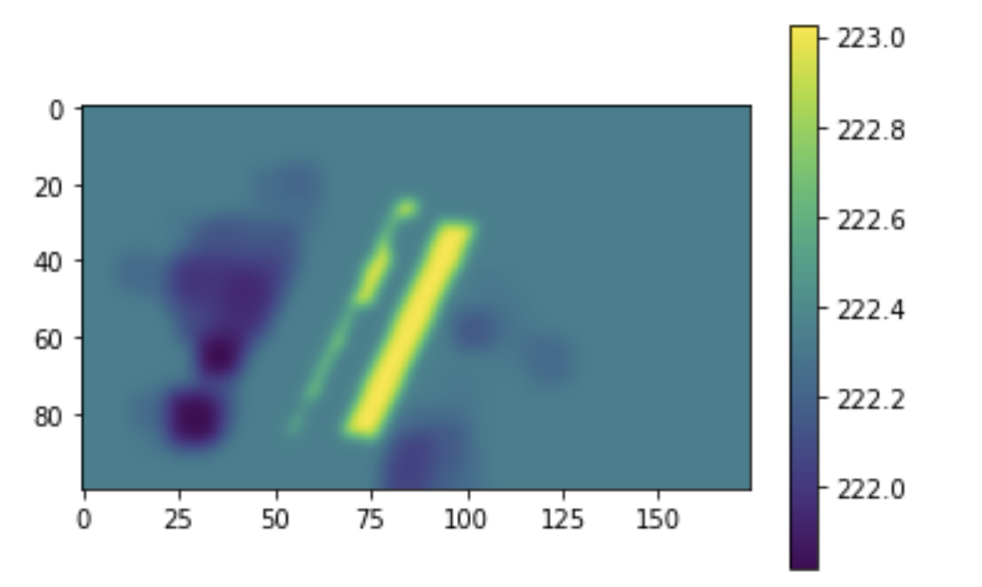
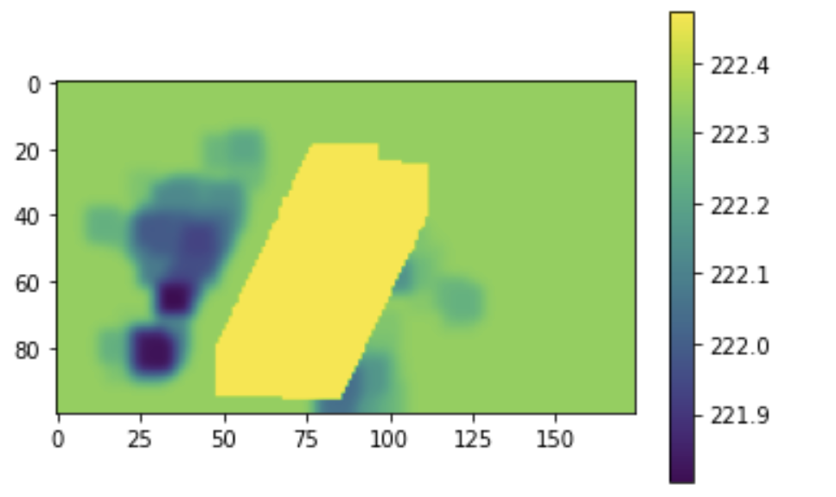
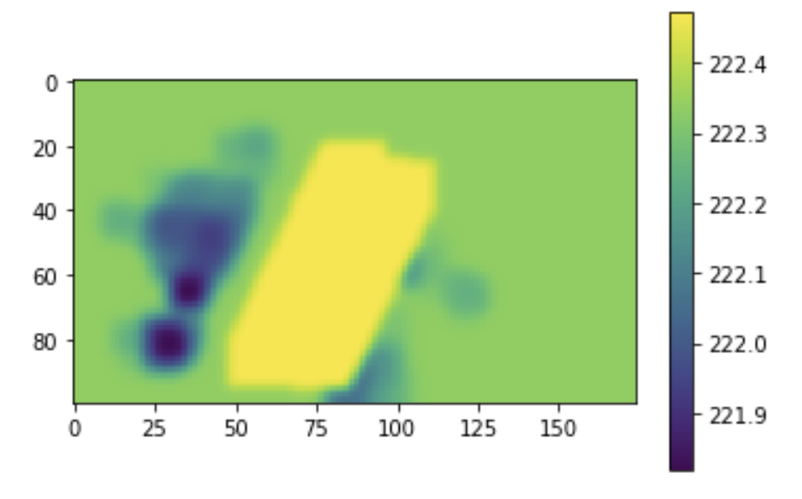
Results
Intermediate Result
Result without Gaussian Blur
Result with Gaussian Blur

Slide 10
Conclusion and Future Works
We were able to generate a terrain model from point cloud data with the help of OpenCV libraries. However, processing of huge Lidar data might not be efficient with this method.
The generation of terrain model can be done for large-scale point cloud data by using CUDA enabled GPU’s or cloud services which provide higher processing power.

Slide 11
References
Digital Terrain Model Generation using LiDAR Ground Points - Andi Zang, Xin Chen, Goce Trajcevski
https://en.wikipedia.org/wiki/Digital_elevation_model
HADOOP-BASED ALGORITHM OF GENERATING DEM GRID FROM POINT CLOUD DATA - 36th International Symposium on Remote Sensing of Environment - X. Jian, X. Xiao, H. Chengfang , Z. Zhizhong, W. Zhaohui , Z. Dengzhong

